Slide 1

Sheet pile
Kratos and probabilistic library
Naam Achternaam

Slide 2
Overview
Sheet pile model, stages
Linear model:
  Variables
  Uncertainty analysis (max displacement x)
  Uncertainty analysis (max bending moment)
Mohr-Coulomb model:
  Variables
  Uncertainty analysis (max displacement x)
  Uncertainty analysis (max bending moment)

Slide 3
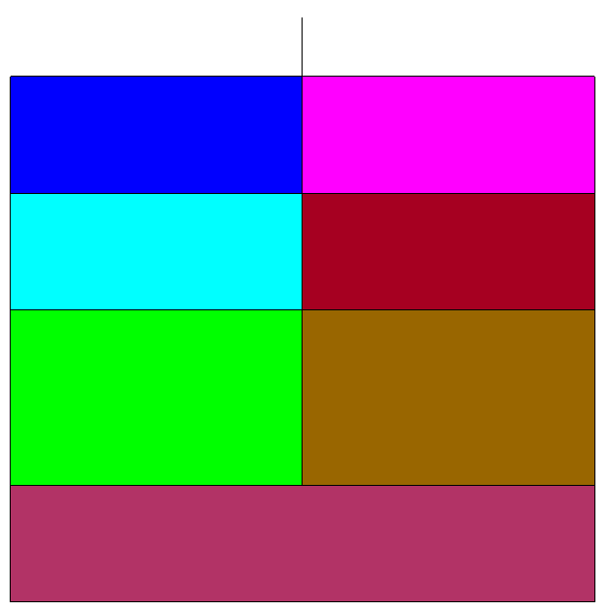
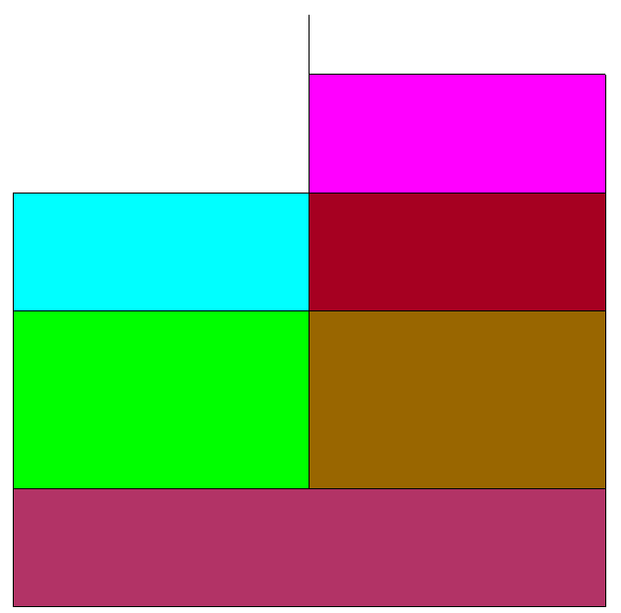

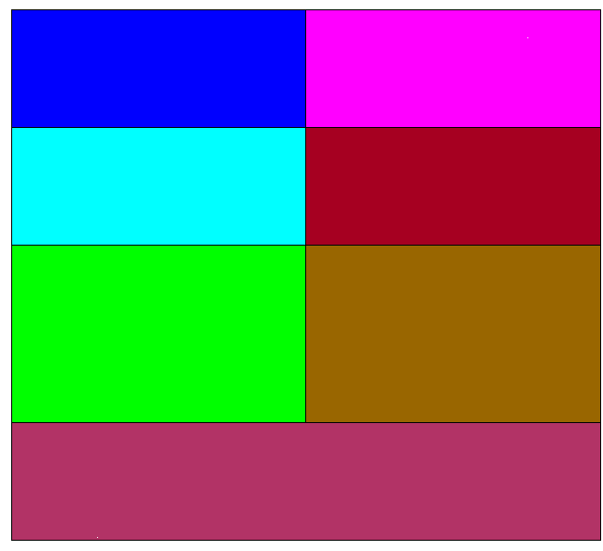
Sheet pile model, stages
Stage 0
Stage 1
Stage 2
Stage 3
Clay (1)
Clay (1)
Clay (1)
Clay (1)
Clay (1)
Clay (1)
Clay (1)
Clay (1)
Clay (2)
Clay (2)
Clay (2)
Clay (2)
Clay (2)
Clay (2)
Clay (2)
Clay (2)
Sand (3)
Sand (3)
Sand (3)
Sand (3)
Sand (3)
Sand (3)
Sand (3)
Sand (3)
Sand (3)
Sand (3)
Sand (3)
Sand (3)

Slide 4
Lineair model

Slide 5
Variables
Input:
Variable | Distribution type | Parameters
Young modulus (clay) | Uniform | 5x10**6 – 8x10**6
Young modulus (sand) | Uniform | 30x10**6 – 50x10**6
Interface stiffness | Deterministic | 10**11
Sheet pile: Young modulus | Deterministic | 200x10**9
Sheet pile: Poisson ratio | Deterministic | 0
Sheet pile: thickness | Deterministic | 0.02159
Output: total displacement x (maaiveld node), max bending moment

Slide 6
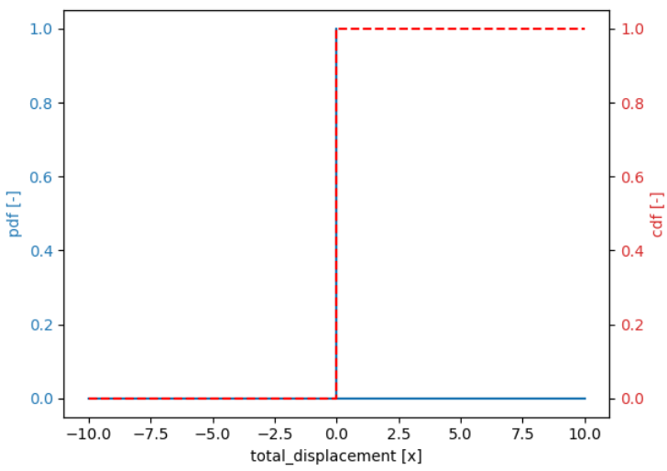
Uncertainty analysis (total displacement x, maaiveld)
Stage 0 (no sheet pile)
Monte Carlo, 50 – 100 samples

Slide 7
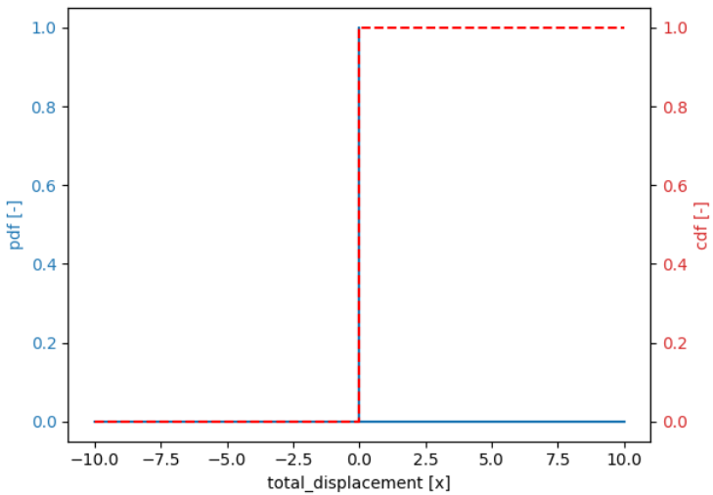
Uncertainty analysis (total displacement x, maaiveld)
Stage 1 (with sheet pile)
Monte Carlo, 50 – 100 samples

Slide 8
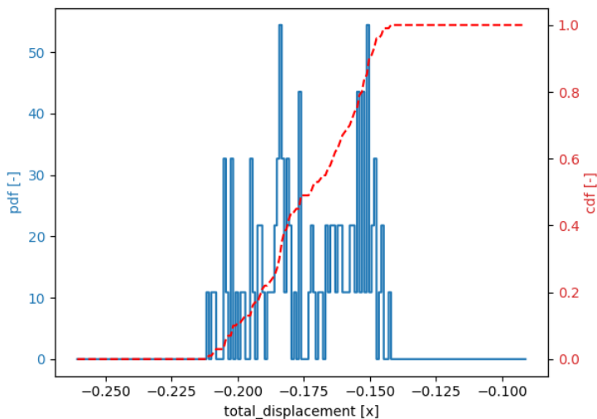
Uncertainty analysis (total displacement x, maaiveld)
Stage 2 (excavation, no anker)
Monte Carlo, 50 – 100 samples

Slide 9
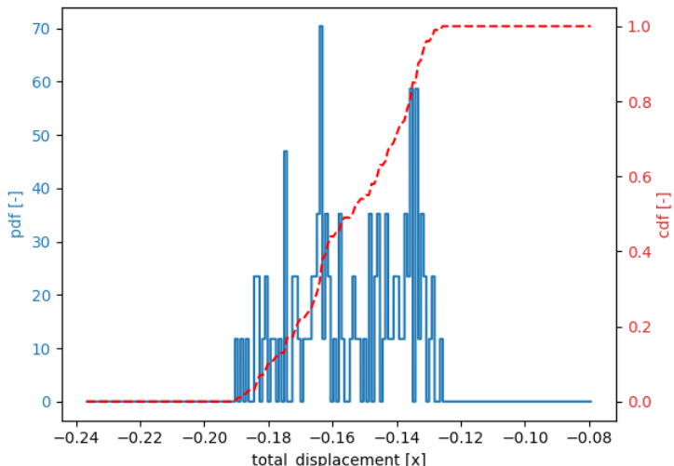
Uncertainty analysis (total displacement x, maaiveld)
Stage 3 (excavation, with anker)
Monte Carlo, 50 – 100 samples

Slide 10
Uncertainty analysis (max bending moment)
Stage 0 (no sheet pile)
Monte Carlo, 50 – 100 samples
No results returned, but there was no sheet pile

Slide 11
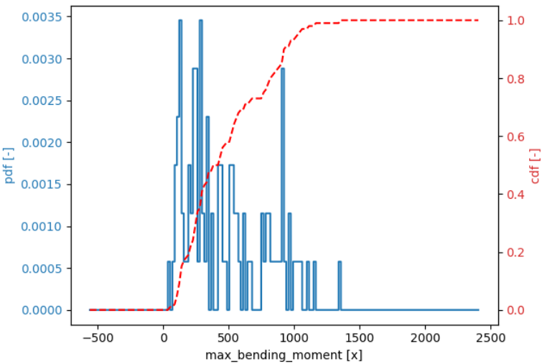
Uncertainty analysis (max bending moment)
Stage 1 (with sheet pile)
Monte Carlo, 50 – 100 samples

Slide 12
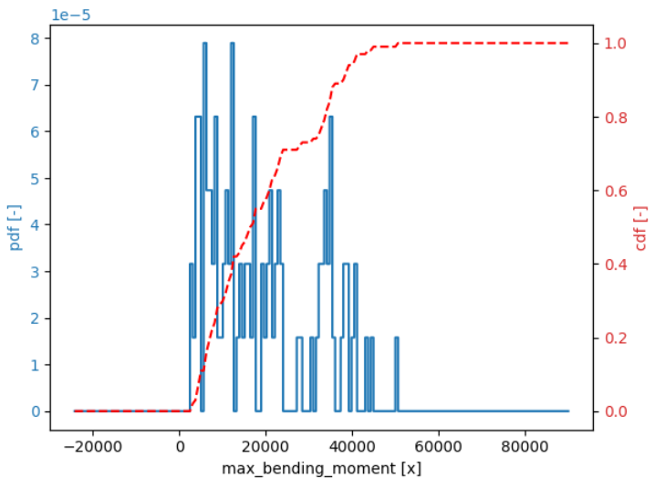
Uncertainty analysis (max bending moment)
Stage 2 (excavation, no anker)
Monte Carlo, 50 – 100 samples

Slide 13
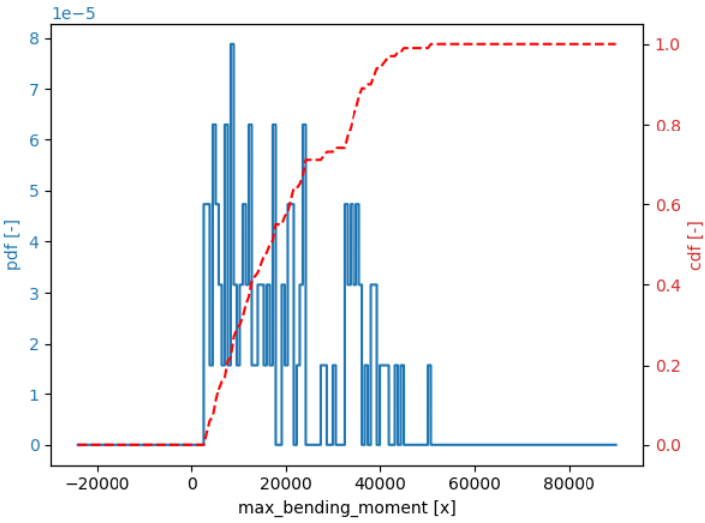
Uncertainty analysis (max bending moment)
Stage 3 (excavation, with anker)
Monte Carlo, 50 – 100 samples

Slide 14
Mohr-Coulomb model

Slide 15
Variables
Input:
Variable | Distribution type | Parameters
Cohesion | Log-normal | Mu = 3, CoV = 0.2
Friction angle (clay) | Log-normal | Mu = 22.5, CoV = 0.08
Friction angle (sand) | Log-normal | Mu = 32.5, CoV = 0.08
Young modulus (clay) | Uniform | 5x10**6 – 8x10**6
Young modulus (sand) | Uniform | 30x10**6 – 50x10**6
Sheet pile: Young modulus | Deterministic | 200x10**9
Sheet pile: Poisson ratio | Deterministic | 0
Sheet pile: thickness | Deterministic | 0.02159
Interfaces (cohesion, friction angle) | The same as soil | The same as soil
Output: total displacement x (maaiveld node), max bending moment

Slide 16
Uncertainty analysis (max total displacement)
Stage 0 (no sheet pile)
Stage 1 (with sheet pile)
Stage 2 (excavation, no anker)
Monte Carlo, 10 - 50 samples

Slide 17
Uncertainty analysis (max total displacement)
Stage 3 (excavation, with anker)
Monte Carlo, 10 - 50 samples

Slide 18
Uncertainty analysis (max bending moment)
Stage 0 (no sheet pile)
Monte Carlo, 10 – 50 samples
No results returned, but there was no sheet pile

Slide 19
Uncertainty analysis (max bending moment)
Stage 1 (with sheet pile)
Monte Carlo, 10 – 50 samples

Slide 20
Uncertainty analysis (max bending moment)
Stage 2 (excavation, no anker)
Monte Carlo, 10 – 50 samples

Slide 21
Uncertainty analysis (max bending moment)
Stage 3 (excavation, with anker)
Monte Carlo, 10 – 50 samples

Slide 22
Verbeterpunten
Lineair model:
  Interfaces aanpassen in het lineair model (normal, 10**11)
  Klei: Volume gewicht + young modulus
  Totale displacement, op het maaiveld ter plaatse van de damwand (met teken) → maaiveld node 171
  Onder + 2 net boven → zand
  Correlatie
Mohr-Coloumb:
  Klei: Volume gewicht + young modulus
  Totale displacement, op het maaiveld ter plaatse van de damwand (met teken) → maaiveld node 171
  Onder + 2 net boven → zand
  Interfaces: net als bij grond
  Correlatie

